Slide 1








IDSR Generic Synthetic Dataset v3
Tathagata Bhattacharjee
LSHTM

Slide 2
Key Topics
Introduction
Generic Synthetic Data
Entity-Relationship Diagram
Data Profile

Slide 3

What is IDSR?
Integrated Disease Surveillance and Response (IDSR) is a strategy adopted by countries in the WHO African Region for implementing comprehensive public health surveillance and response systems for priority diseases, conditions and events at all levels of health systems
The IDSR framework makes surveillance and laboratory data more usable, helping public health managers and decision-makers improve detection and response to the leading causes of illness, death, and disability in African countries
CDC has played a leading role in designing, developing, implementing, monitoring and evaluating IDSR since its inception in 1988.
With funding from USAID, CDC’s IDSR team collaborated with WHO/AFRO to lead the development of the IDSR framework and the design and development of the Technical Guidelines for Integrated Disease Surveillance and the IDSR Training Modules
The IDSR strategy incorporates both Indicator-Based surveillance (IBS) and Event-Based Surveillance (EBS) approaches to early detection of priority diseases, conditions and events.
References:
https://www.cdc.gov/globalhealth/healthprotection/idsr/index.html
https://openwho.org/channels/idsr

Slide 4
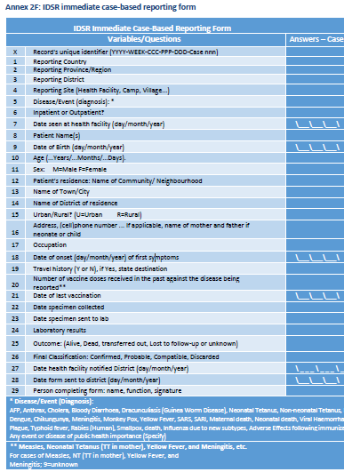
Source Form
Technical Guidelines for Integrated Disease Surveillance and Response in the African Region: Third edition
https://www.afro.who.int/publications/technical-guidelines-integrated-disease-surveillance-and-response-african-region-third
Booklet two: Section 1,2 and 3
https://apps.who.int/iris/bitstream/handle/10665/312317/WHO-AF-WHE-CPI-01-2019-eng.pdf
Annex 2F: IDSR immediate case-based reporting form (page 92)

Slide 5
IDSR Generic Synthetic Data
Why generic?
This dataset does not represent any country or region-specific characteristics of population demographics, disease incidences and prevalence, trends or any scientific analysis results from the dataset.
This dataset is pure fictional for the purpose of demonstrations, trainings and learning.
Data storage?
This generic synthetic dataset has been stored in a PostgreSQL database and distributed as a PostgreSQL database backup file
Production:
This generic synthetic dataset has been generated using the following software tools –
(a) Microsoft Excel, (b) PostgreSQL database, (c ) JavaScript and (d) Pentaho Data Integration.
This generic synthetic dataset focus only on COVID-19 (SARS-CoV-2) disease for one instance of surveillance and response for one participant (person).
The database is designed accordingly to store one instance of the Annex 2F form for one participant (person).

Slide 6
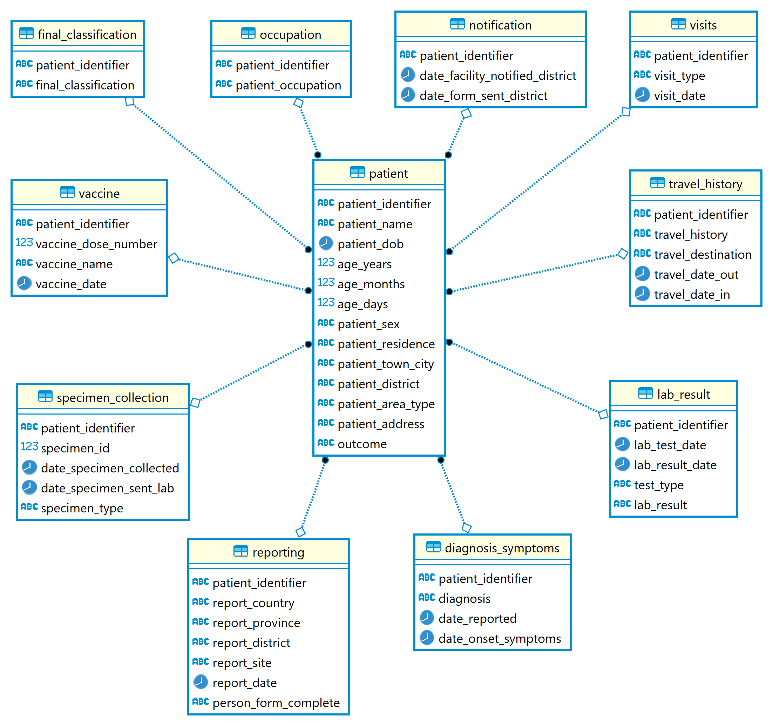
Entity-Relationship Diagram
This ER diagram has been drawn using DBeaver Community Edition Version 23.1.2.202307091549

Slide 7
Data Profile: Patient
Total count: 51299
Area type
Urban: 30627
Rural: 30627
Sex
Male: 31979
Female: 19320
Patient Age
Highest: 87
Lowest: 0
Mean: 24.909
Median: 19
Date of Birth
Highest: 2021-12-28
Lowest: 1935-01-01
Mean: 1996-02-11
Median: 2002-04-05
Data profiling of the IDSR Generic Synthetic data has been done using DataCleaner Community editionn5.8.1

Slide 8
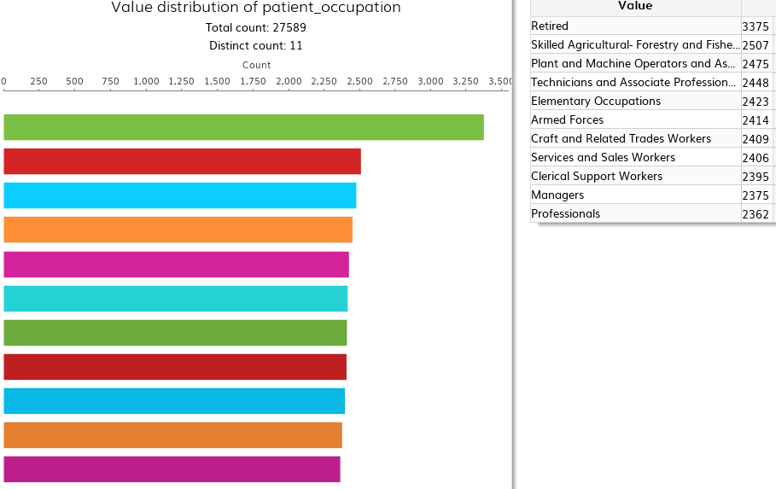
Data Profile: Occupation

Slide 9
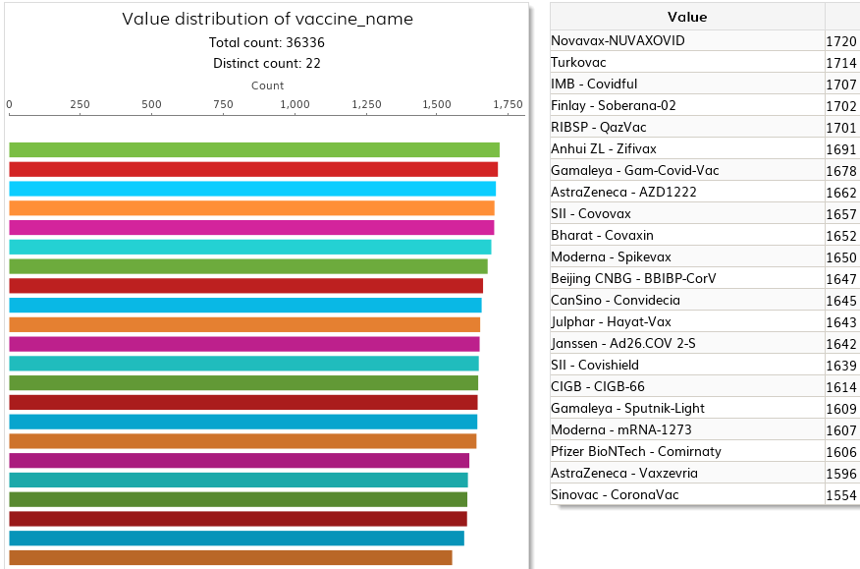
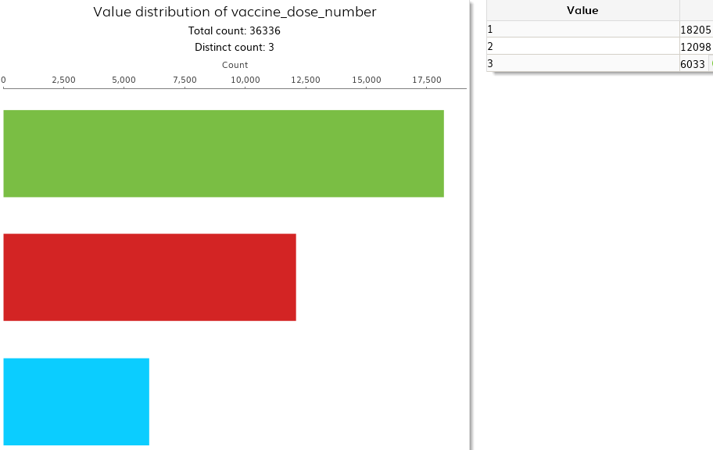
Data Profile: Vaccines (Covid-19 Vaccines)
Total population vaccinated: 18205
Highest vaccination date: 2023-02-07
Lowest vaccination date: 2019-10-22
Doses | Count
Only 1 dose | 6107
Only 2 doses | 6065
All 3 doses | 6033

Slide 10
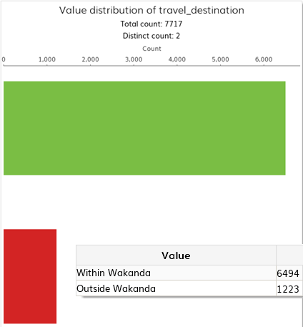
Data Profile: Travel History

Slide 11
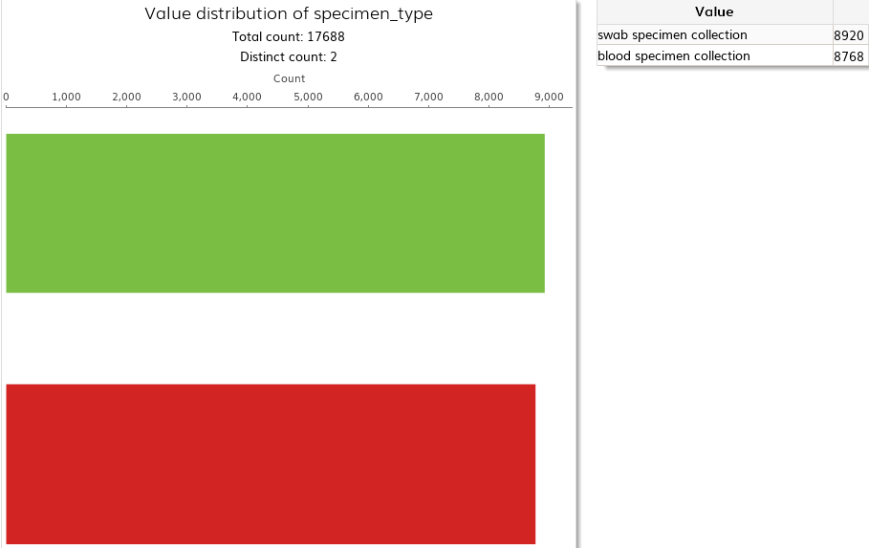
Data Profile: Specimen Collection
 | specimen_collected | specimen_sent_lab
Number of collections | 17688 | 17688
Highest date | 14-11-2022 | 15-11-2022
Lowest date | 19-02-2020 | 19-02-2020
Specimen Collection | Count
One (Only Blood) | 4319
One (Only Swab) | 4471
Two (Blood and Swab) | 4449

Slide 12
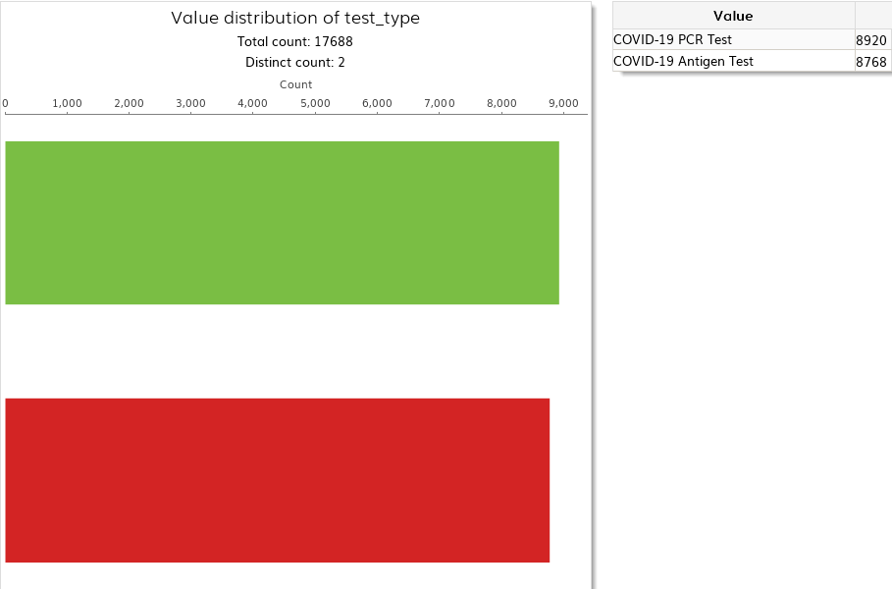
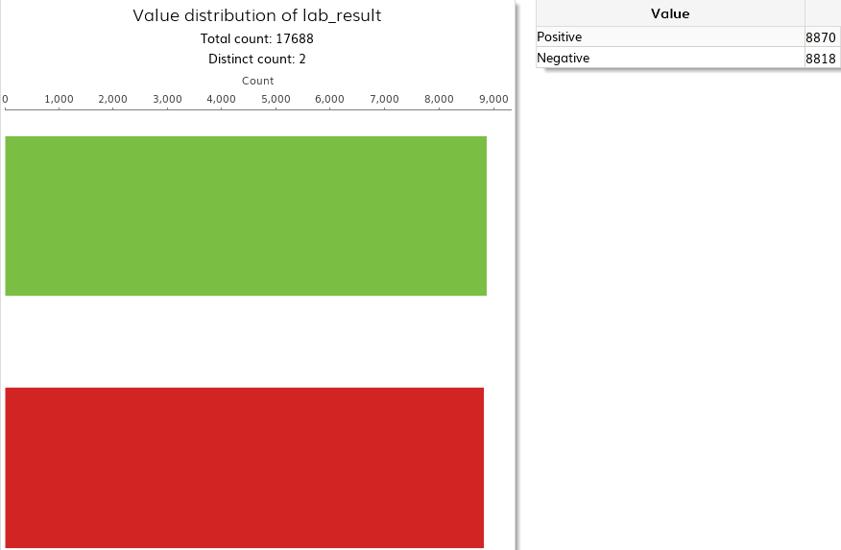
Data Profile: Laboratory Tests
 | lab_test_date | lab_result_date
Number of Lab Resuts | 17688 | 17688
Highest date | 15-11-2022 | 15-11-2022
Lowest date | 19-02-2020 | 19-02-2020
Lab Tests | Count
One (Only Antigen) | 4319
One (Only PCR) | 4471
Two (Antigen and PCR) | 4449

Slide 13
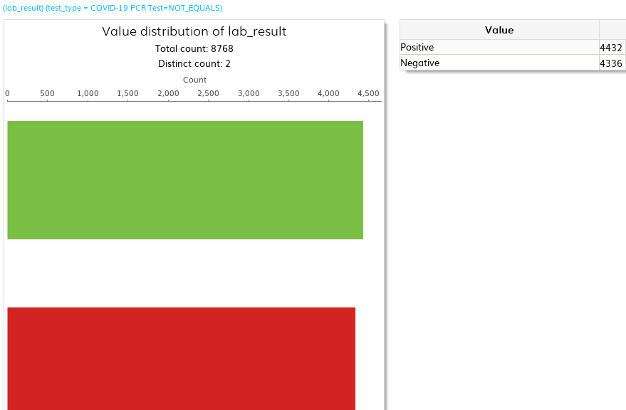
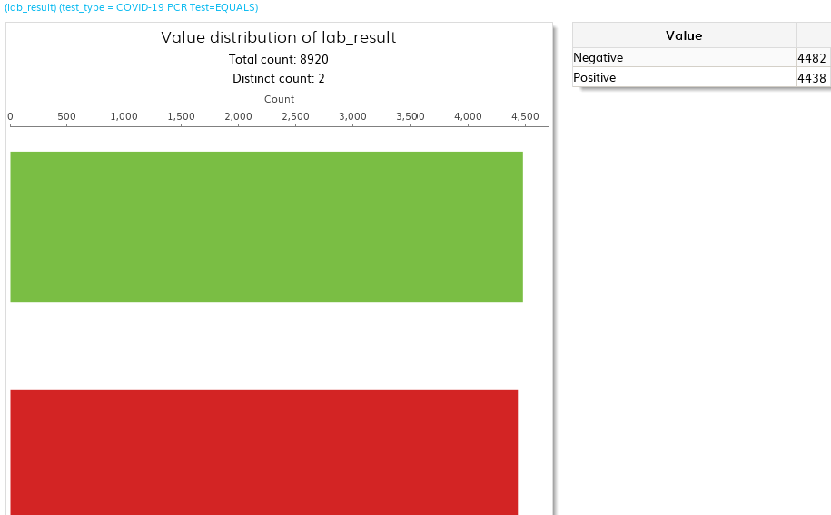
Data Profile: Laboratory Results
COVID-19 Antigen Test Results
COVID-19 PCR Test Results

Slide 14

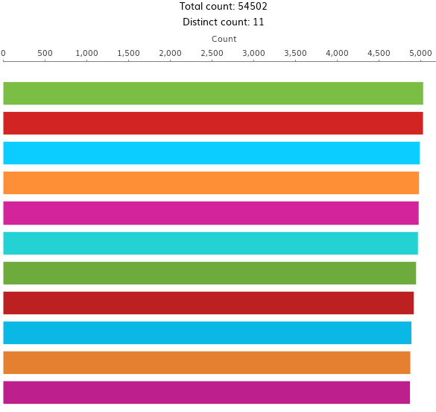
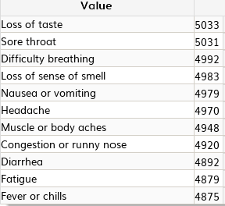
Data Profile: Diagnosis and Symptoms
Symptoms

Slide 15
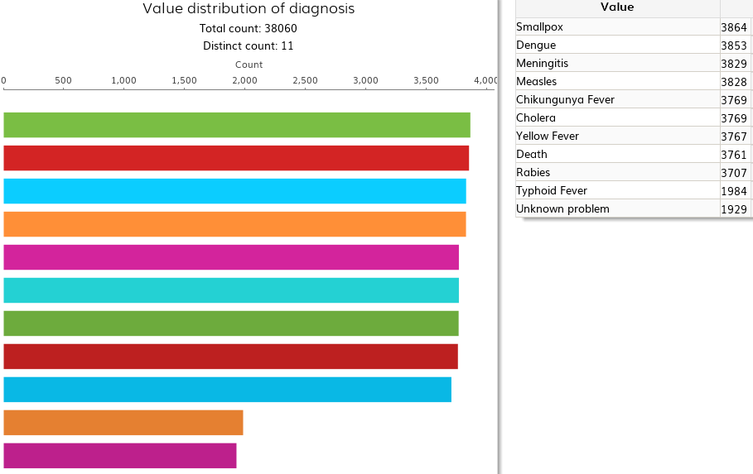
Data Profile: Other Diagnosis

Slide 16
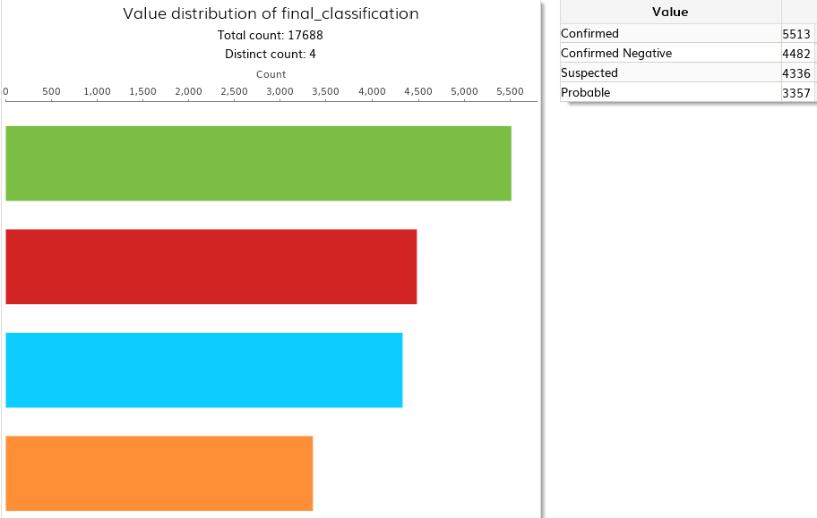
Data Profile: Final Classification

Slide 17
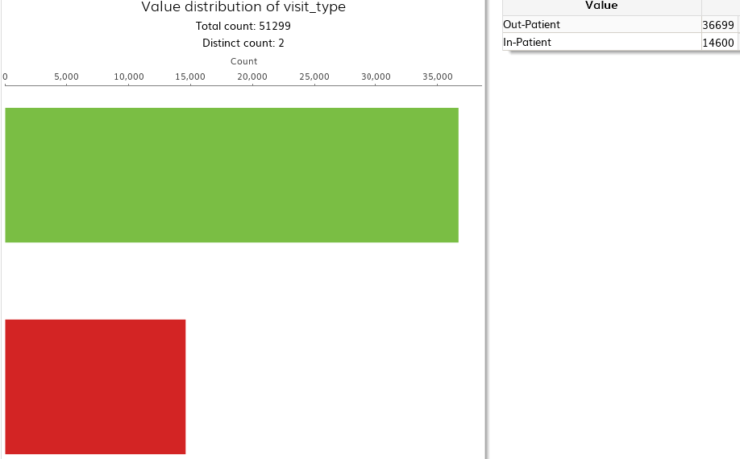
Data Profile: Patient Visits

Slide 18

Thank you

